Slide 1
WIFI
Wi-Fi and 802.11 Protocol Overview
Wi-Fi is a wireless networking technology that allows devices to communicate over radio waves without physical cables.
Based on IEEE 802.11 standards.
Commonly used for local area networking (WLAN) in homes, offices, and public areas.
📘 IEEE 802.11 Standard:
A family of specifications that define the PHY (physical) and MAC (medium access control) layers for wireless LANs.
Published by the Institute of Electrical and Electronics Engineers (IEEE).

Slide 2
📶 How Wi-Fi (802.11) Works:
Access Point (AP): Acts as the central device; broadcasts SSID and manages wireless communication.
Client Devices (e.g., laptops, phones): Scan for available networks and connect to the AP.
Channel Selection: Devices communicate on a specific channel within the 2.4 GHz or 5 GHz (and now 6 GHz) bands.
MAC Layer: Manages access to the medium using CSMA/CA (Carrier Sense Multiple Access with Collision Avoidance).
Encryption: Ensures secure communication (e.g., WPA3, WPA2).

Slide 3
Different Wi-Fi versions:
Protocol | Name (Wi-Fi version) | Year Released | Max Speed (Theoretical) | Frequency Bands | Key Features
802.11 | — | 1997 | 2 Mbps | 2.4 GHz | First standard, now obsolete.
802.11b | Wi-Fi 1 | 1999 | 11 Mbps | 2.4 GHz | First widely adopted Wi-Fi standard.
802.11a | Wi-Fi 2 | 1999 | 54 Mbps | 5 GHz | Faster than 11b, but with shorter range.
802.11g | Wi-Fi 3 | 2003 | 54 Mbps | 2.4 GHz | Combined benefits of 802.11a and 11b.

Slide 4
Protocol | Name (Wi-Fi version) | Year Released | Max Speed (Theoretical) | Frequency Bands | Key Features
802.11n | Wi-Fi 4 | 2009 | 600 Mbps | 2.4 & 5 GHz | Introduced MIMO (Multiple-Input, Multiple-Output).
802.11ac | Wi-Fi 5 | 2013 | 1.3–6.9 Gbps | 5 GHz | Beamforming, wider channels, MU-MIMO.
802.11ax | Wi-Fi 6 | 2019 | ~9.6 Gbps | 2.4 & 5 GHz | Higher efficiency, OFDMA, improved performance in crowded areas.
802.11ax (Wi-Fi 6E) | Wi-Fi 6E | 2021 | ~9.6 Gbps | 2.4, 5 & 6 GHz | Extension of Wi-Fi 6 into the 6 GHz band.
802.11be | Wi-Fi 7 | 2024 (est.) | ~46 Gbps | 2.4, 5 & 6 GHz | Multi-link operation, 320 MHz channels, 4096-QAM, extreme speed & low latency.

Slide 5
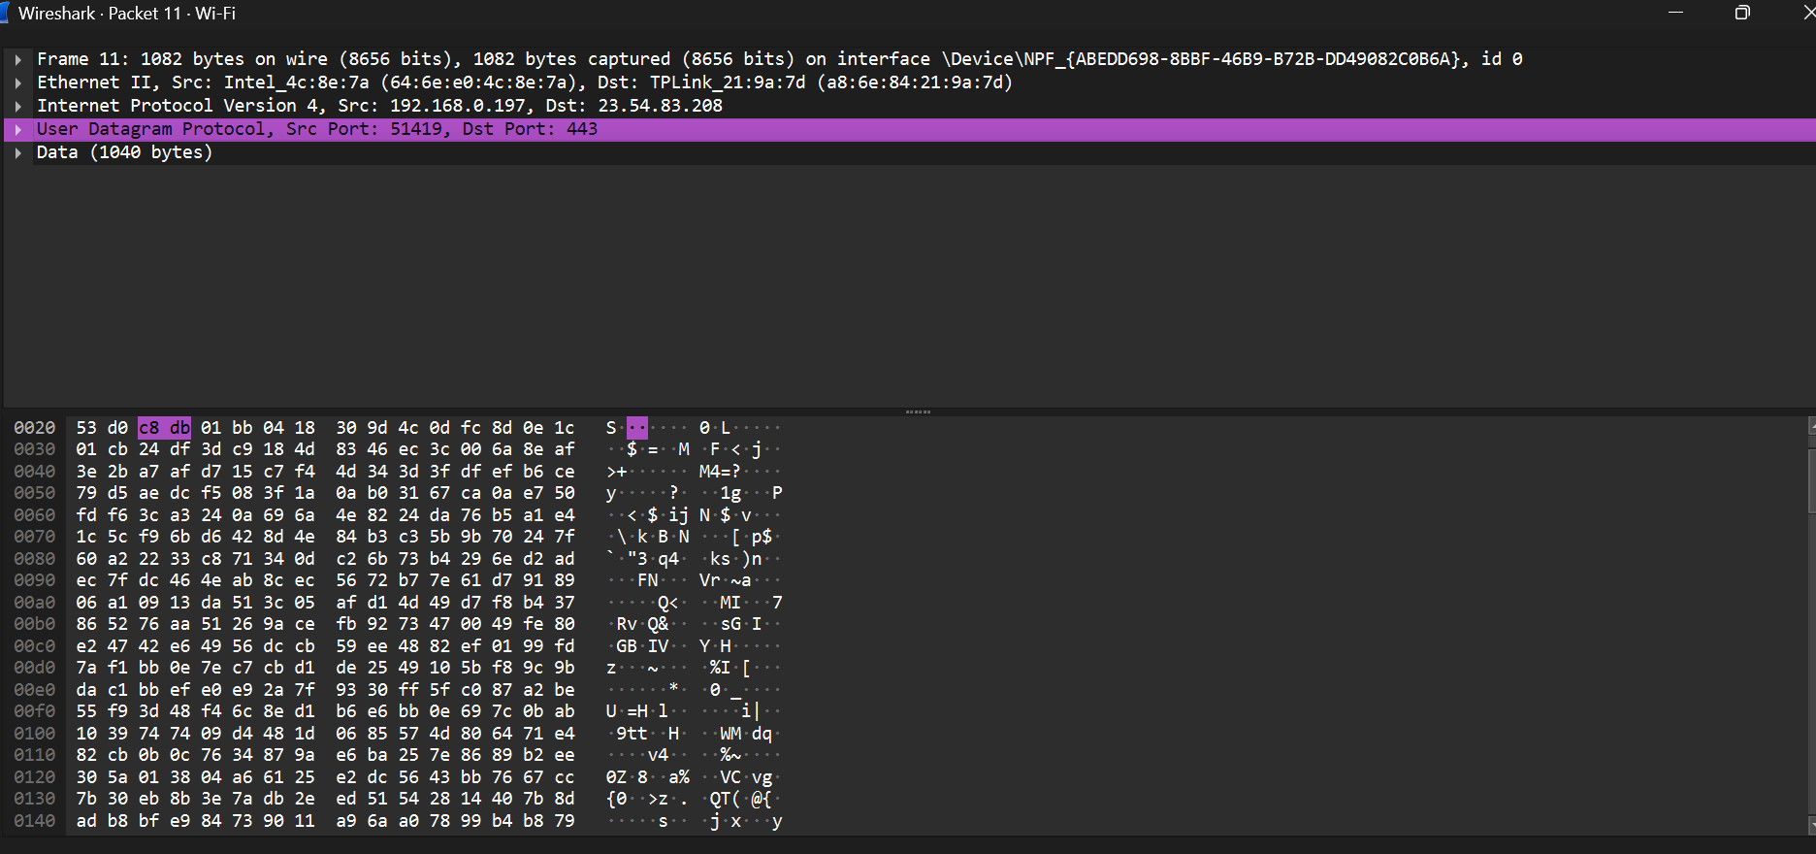
Structure

Slide 6
Explanation
1. Frame Level (Capture Summary)
Size on wire: 1082 bytes (8656 bits) — this is the total size of the packet as transmitted on the physical medium.
Size captured: 1082 bytes — full packet was captured.
Interface: \Device\NPF_{ABEDD698-8BBF-46B9-B72B-DD49082C0B6A} — the network interface that captured the packet.
2. Layer 2 – Data Link Layer (Ethernet II)
Source MAC address: 64:6e:e0:4c:8e:7a → vendor lookup suggests it's an Intel device.
Destination MAC address: a8:6e:84:21:9a:7d → likely a TP-Link device.
Ethernet Type: The type isn't listed, but based on the next layer being IP, it would be 0x0800 (IPv4).

Slide 7
3. Layer 3 – Network Layer (IPv4)
Source IP address: 192.168.0.197 → a private/internal IP address.
Destination IP address: 23.54.83.208 → a public IP address, likely a content delivery network (e.g., Akamai or another CDN).
This tells us the device is reaching out from a local network to a public server.
4. Layer 4 – Transport Layer (UDP)
Protocol: UDP (User Datagram Protocol)
Source port: 51419 → usually a random high port, used by client.
Destination port: 443 → commonly used for HTTPS (but HTTPS usually uses TCP, so this may be a special use case like QUIC over UDP).
⚠️ Port 443 using UDP strongly suggests the use of QUIC protocol (used by HTTP/3), which allows HTTP traffic over UDP for performance improvements.
5. Layer 7 – Application Layer (Data)
Data length: 1040 bytes
Since the protocol is UDP and the destination port is 443, this is most likely HTTP/3 over QUIC.
The exact content of the data isn't shown here, but this is typically encrypted in modern HTTPS traffic.

Slide 8
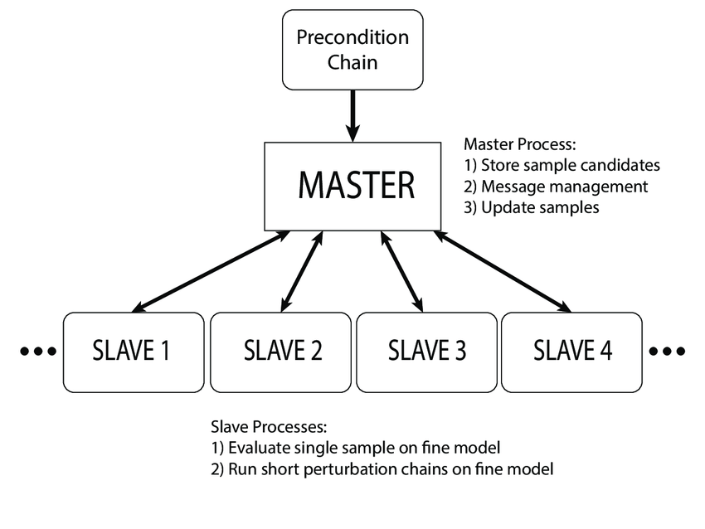
LIN (Local interconnect network) protocol:
-
-Master-Slave architecture
-Speed up to 20kbit/s
-Single wire communication for data transmission
-provide less security as compared to CAN protocol
-Used in aplication where require less security like window up/down, wiper etc.
-There are different version of LIN such as LIN 1.0.1.1,1.2,2.0.2.1.2.2 and 3.0
-Out of which 2.1 and 2.2A are widely because of more flexibilty and improved performance and 3.0 currently is development phase not widely adopted in
Automotive.

Slide 9
Frame structure:
1. Break Field (13+ bits)
Purpose: Signals the start of a new LIN message.
How: Transmits a dominant low signal for at least 13 bit times (longer than normal "start bit").
Size: Not always visible in software (like our UDP simulation) – simulated as a flag.
2. Sync Field (1 byte)
Value: Always 0x55 (01010101)
Purpose: Allows slaves to measure and sync to master's baud rate.
Size: 8 bits (1 byte)

Slide 10
3. Identifier Field (1 byte)
Structure: ID[5:0] + P0 + P1
6 bits: Actual Message ID
2 bits: Parity bits (calculated for error detection)
Range: 0x00 to 0x3F (for actual IDs)
Size: 8 bits (1 byte)
4. Data Field (1–8 bytes)
Payload: Variable length (depends on message type)
Examples:
Engine ON: 0x01
Door Status: [0x00, 0x01]
Size: 1 to 8 bytes

Slide 11
5. Checksum Field (1 byte)
Data bytes only (Classic Checksum)
Or Data + ID (Enhanced Checksum) – used in LIN 2.0+
Size: 8 bits (1 byte)

